Slide 1



Idea/Approach Details Ministry/ Organization name: GOVT OF SIKKIM Problem Statement :Transparency and Safeguard measures in HR Management Problem category: Software Problem Code: SG296 Technology Software :Web application Development Team Name : Scan B Team Leader Name : T PALLAVI College Code : 1-3514007449

Slide 2
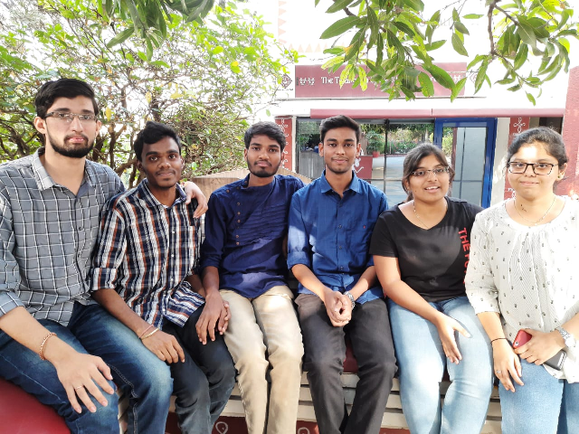
OUR TEAM SCAN-B@MLRITM

Slide 3


Slide 4
Problem Description
An Application to monitor all file movements of every employee,timely information,intimation to the employees through SMS,emails.
All files should be traceable online so that the employee do not run after the file.
For this purpose whenever a file enters the system put a sticker (barcode/QR code) on the file and then whenever a file moves out of the warehouse, goes for signature, the sticker should be scanned to update its status. This system should provide insights like estimated turn around time, at each stage. Number of stages for a type of application.
Additionally it should provide intimation to the employees who are supposed to take action on them on a dashboard. Additionally if they delay taking action provide notification by SMS/email.

Slide 5
SOLUTION
Instead of carrying the files we can stick a QR Code
On the cover of the file,Which contains all the softcopy
Data of the file .
By Scanning we can retrive the data
We can also update status of the file whether it is pending or approved ,this will be shown in the web application .
This application also contain employee data and we can add them whoever is involved in the respective file data the application also contains the grievance system .

Slide 6
ADVANTAGES
It is much cheaper as the hardware is available for low price and the software is available free of cost as it is open source
It will not delay or slow the Internet traffic in any way

Slide 7

ARCHITECTURE OF SOLUTION

Slide 8




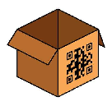

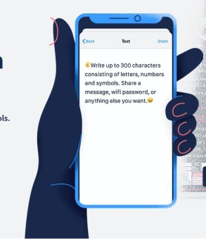

CLOUD STORAGE
ENCRYPTED DATABASE
FILES
SECURED
QR CODE
SCANNER
AUTHENTICATION
FILES
GET NOTIFIED

Slide 9







TECHNOLOGIES USED
PYTHON3
QR TOOLS
PILLOW LIBRARY
TKINTER GUI
TRUE CRYPT
APP INVENTOR
MY SQL

Slide 10
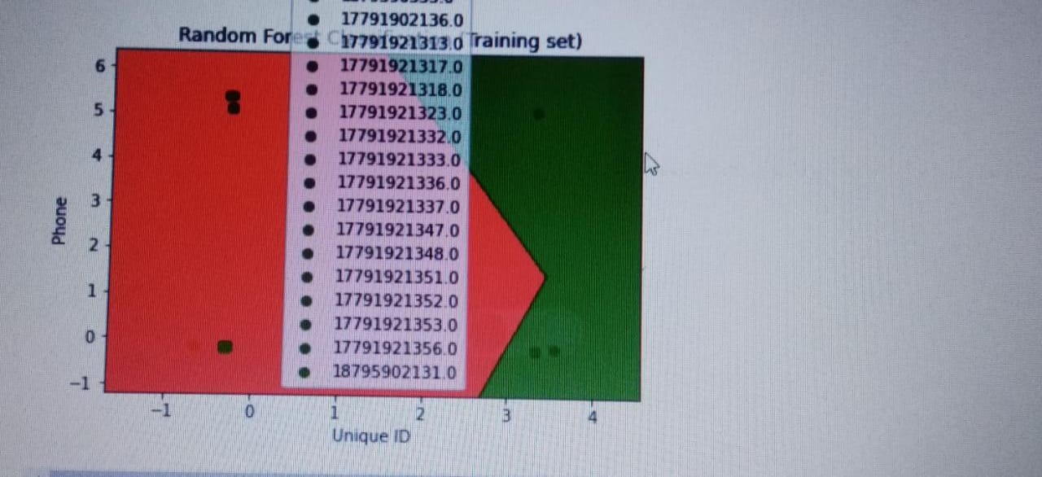
Phone vs Uniqueid

Slide 11
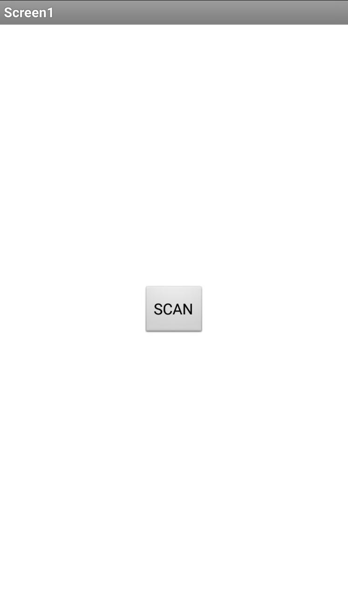
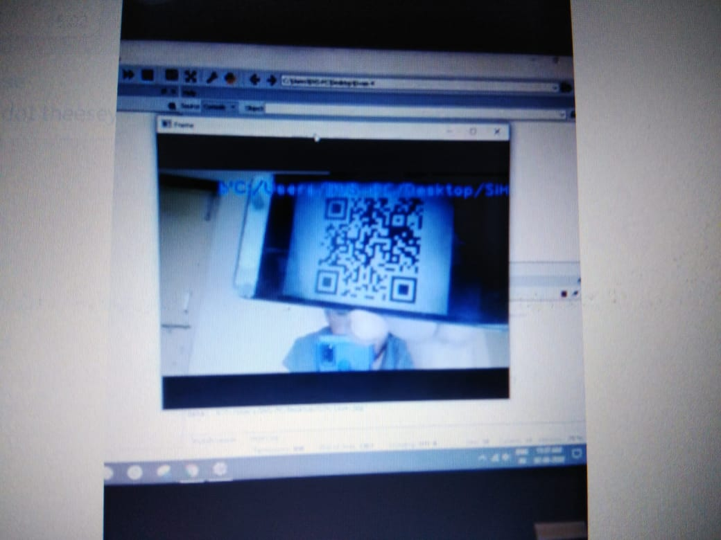
QR code Generator

Slide 12
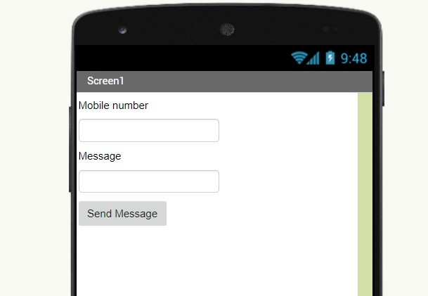
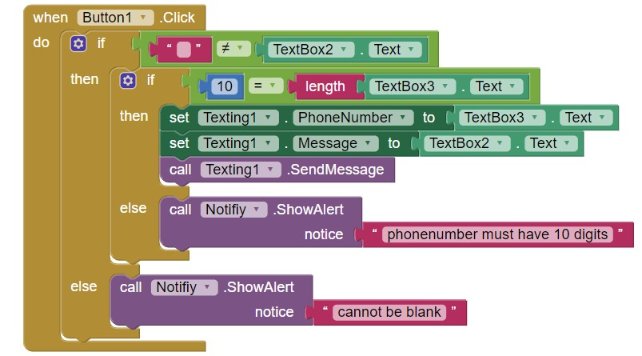
Message Generator

Slide 13
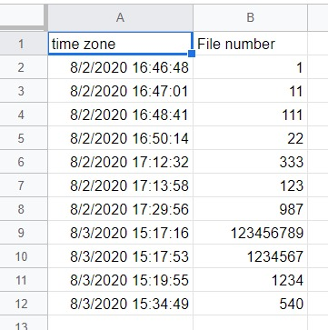
Updated Data

Slide 14


